Slide 1


Bank Clients data
Last data refresh:
1/18/2024 8:24:33 PM UTC
Downloaded at:
1/18/2024 9:07:08 PM UTC

Slide 2
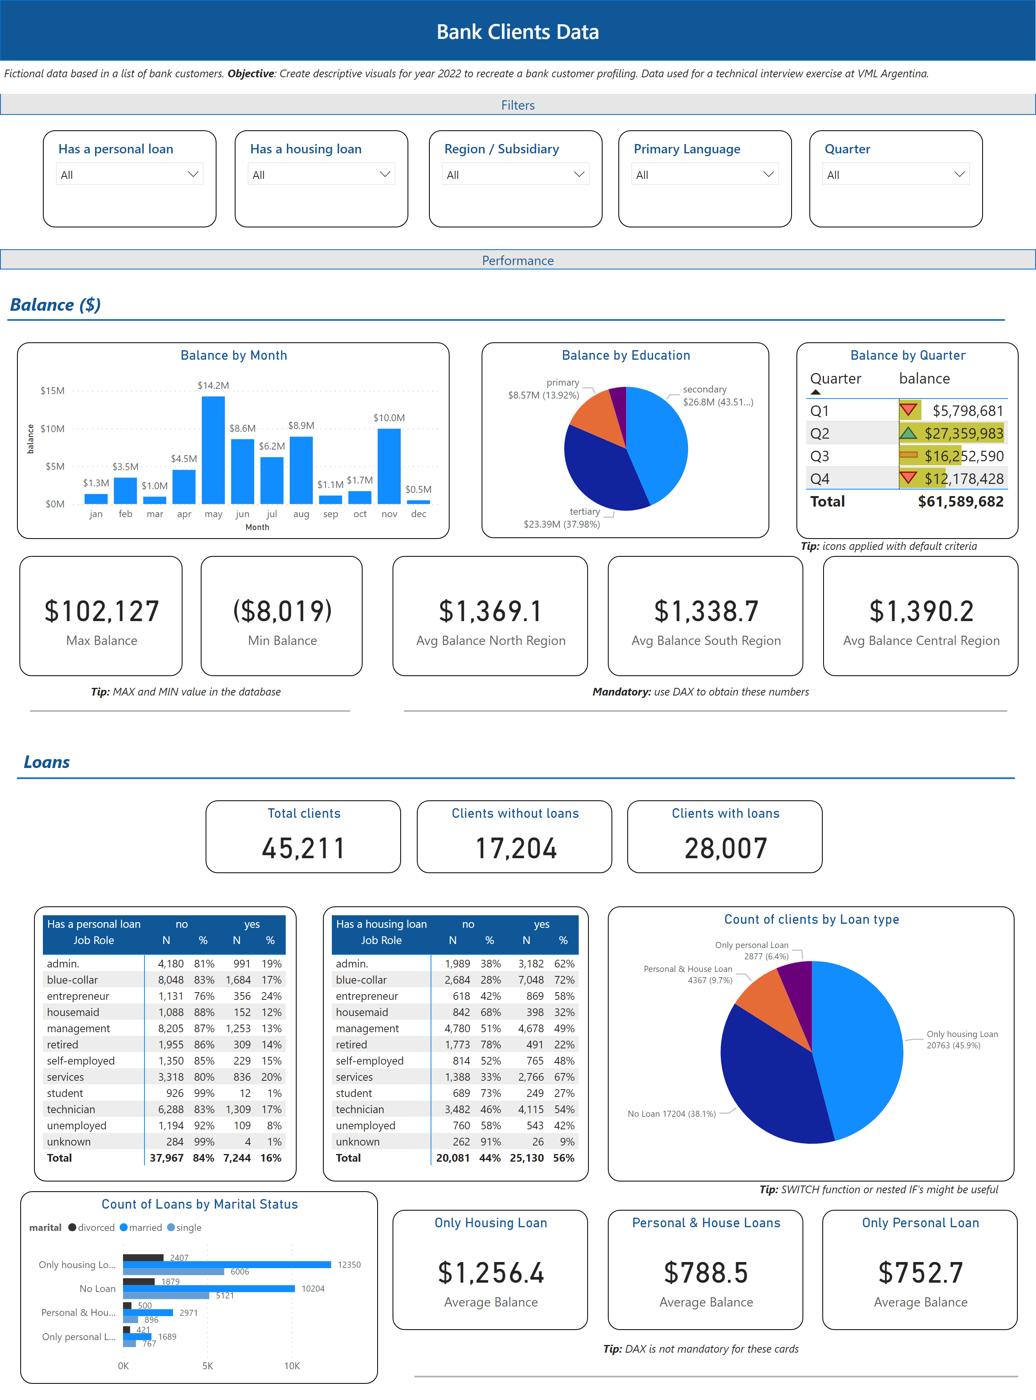
Bank Clients
Notes:
shape
No alt text provided
shape
No alt text provided
slicer
No alt text provided
slicer
No alt text provided
slicer
No alt text provided
slicer
No alt text provided
textbox
No alt text provided
shape
No alt text provided
Balance by Month
No alt text provided
Balance by Education
No alt text provided
Balance by Quarter
No alt text provided
slicer
No alt text provided
card
No alt text provided
card
No alt text provided
textbox
No alt text provided
card
No alt text provided
card
No alt text provided
card
No alt text provided
textbox
No alt text provided
shape
No alt text provided
pivotTable
No alt text provided
pivotTable
No alt text provided
Count of clients by Loan type
No alt text provided
Count of Loans by Marital Status
No alt text provided
Only Housing Loan
No alt text provided
Personal & House Loans
No alt text provided
Only Personal Loan
No alt text provided
textbox
No alt text provided
shape
No alt text provided
shape
No alt text provided
textbox
No alt text provided
shape
No alt text provided
textbox
No alt text provided
shape
No alt text provided
Clients without loans
No alt text provided
Clients with loans
No alt text provided
Total clients
No alt text provided
textbox
No alt text provided
textbox
No alt text provided

Slide 3
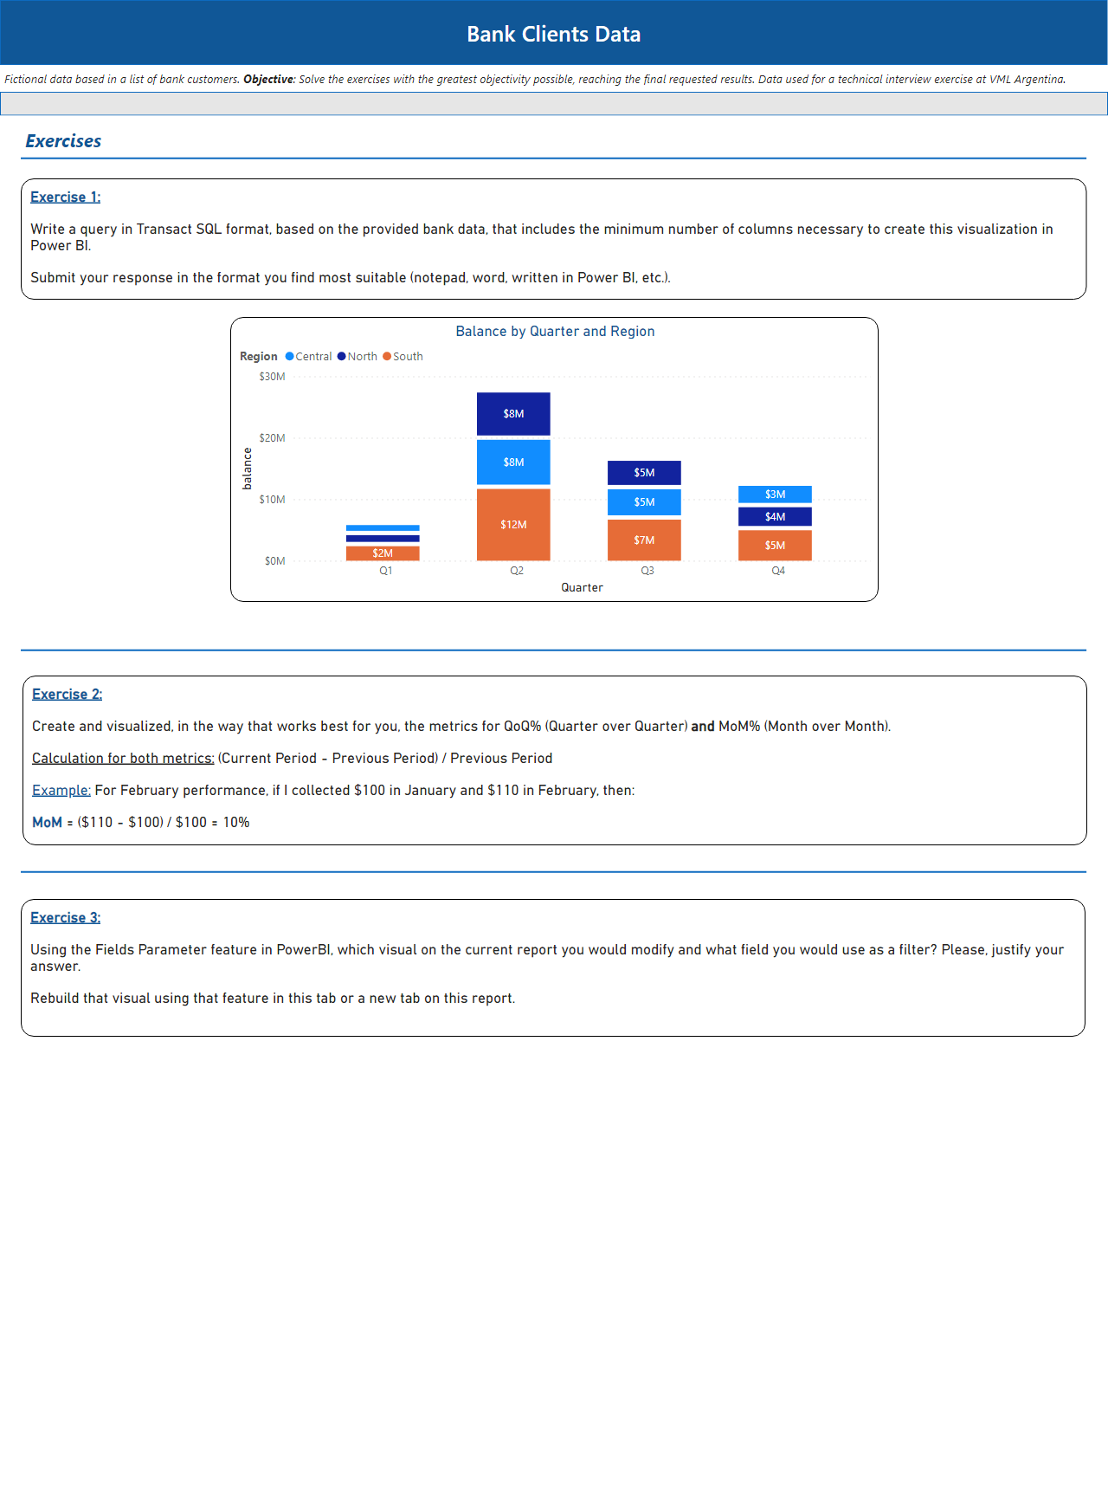
Exercises
Notes:
Balance by Quarter and Region
No alt text provided
textbox
No alt text provided
textbox
No alt text provided
shape
No alt text provided
textbox
No alt text provided
shape
No alt text provided
shape
No alt text provided
shape
No alt text provided
shape
No alt text provided
textbox
No alt text provided
textbox
No alt text provided

